Slide 1
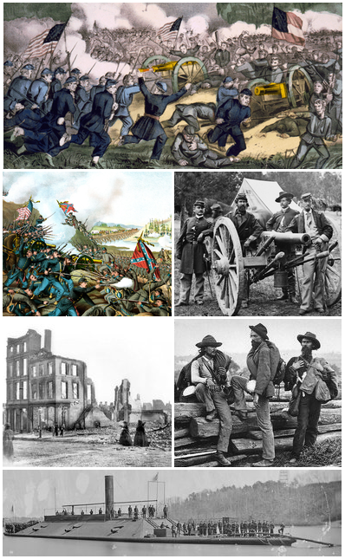
The American Civil War
April 1861 – April 1865

Slide 2
Brief Background…. Very brief!!
Mostly British colonists settled in what is now the USA in the early 17thC.
By the 1770s there were about 2.5m people scattered over 13 colonies, mainly on the north east coast.
The ‘Patriots’ [some of those living in the colonies] protested against taxes imposed by Great Britain – Boston Tea Party in 1773 which led to harsh laws and taxes by the Brits….which led to armed conflict.
1776 – Declaration of Independence….. Led to war which the American colonists led by George Washington won [help from France too].
Constitution adopted in 1789 and Bill of Rights follows in 1791.
Based on the concept of ‘manifest destiny’ colonists and new immigrants spread west to the Pacific over the next century. This led to frontier conflict with the People of the First Nations. The California Gold Rush 1840s hastened the expansion and immigration.
The northern states (mostly the original 13) became increasingly urban and industrial.
The southern states’ economy was based on agriculture, particularly cotton. This was instrumental in forming the ‘slave triangle’ [Africa – southern America – Britain]
By the 1840s ‘abolitionists’ stated that slavery was a sin or at least a social evil (A Lincoln)
This began a secession movement by some southern states which had been building for some time.

Slide 3
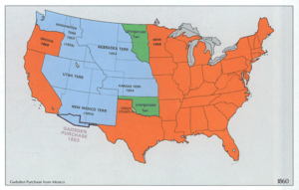
The United States, immediately before the Civil War. All of the lands east of, or bordering, the Mississippi River were organized as states in the Union, but the West was still largely unsettled.

Slide 4
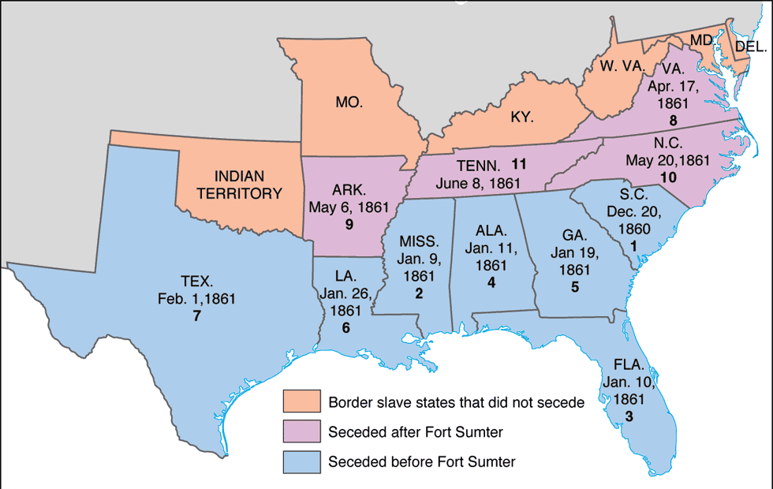
Southern States and secession. Fort Sumter was the3 first battle of the Civil War in 1861.

Slide 5
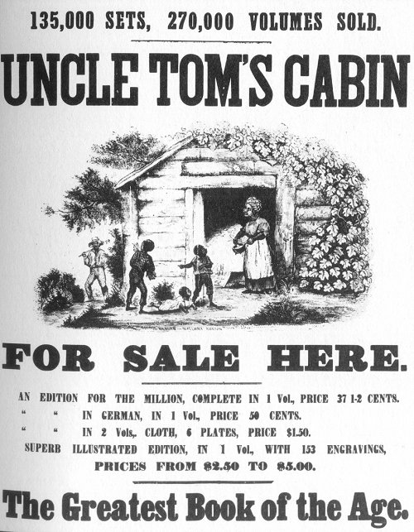
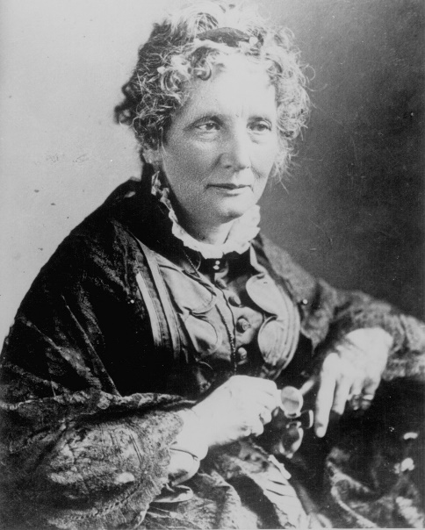
Uncle Tom’s Cabin by Harriet Beecher Stowe
1852
Sold 300,000 copies in the first year.
2 million in a decade!

Slide 6
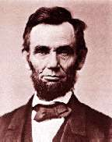
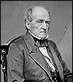
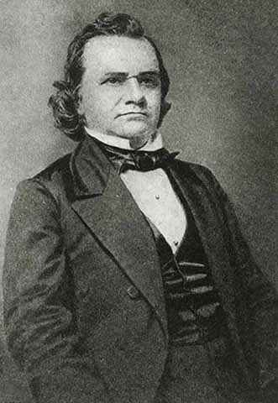
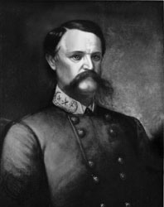
1860 Presidential Election
√ Abraham Lincoln Republican
John Bell Constitutional Union
Stephen A. Douglas Northern Democrat
John C. Breckinridge Southern Democrat

Slide 7
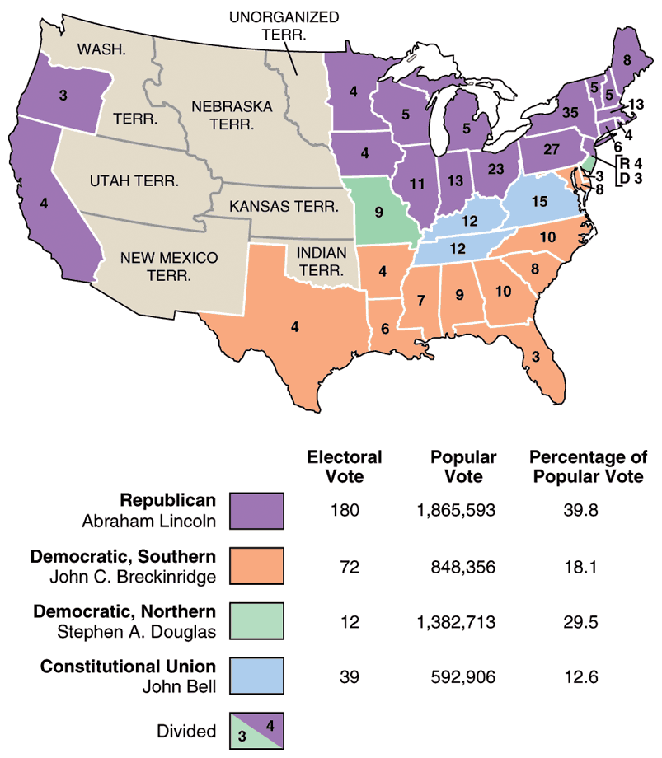

Slide 8
Go to Civil War ppt….. ☺

Slide 9
References:
https://civilwar.mrdonn.org/powerpoints.html
https://en.wikipedia.org/wiki/History_of_the_United_States

